Slide 1

Single-cell RNA-seq Analysis of Tumor Microenvironment
This presentation explores our comprehensive analysis of tumor microenvironment using single-cell RNA sequencing technology. We've identified distinct tumor subtypes and characterized their molecular signatures.

Slide 2


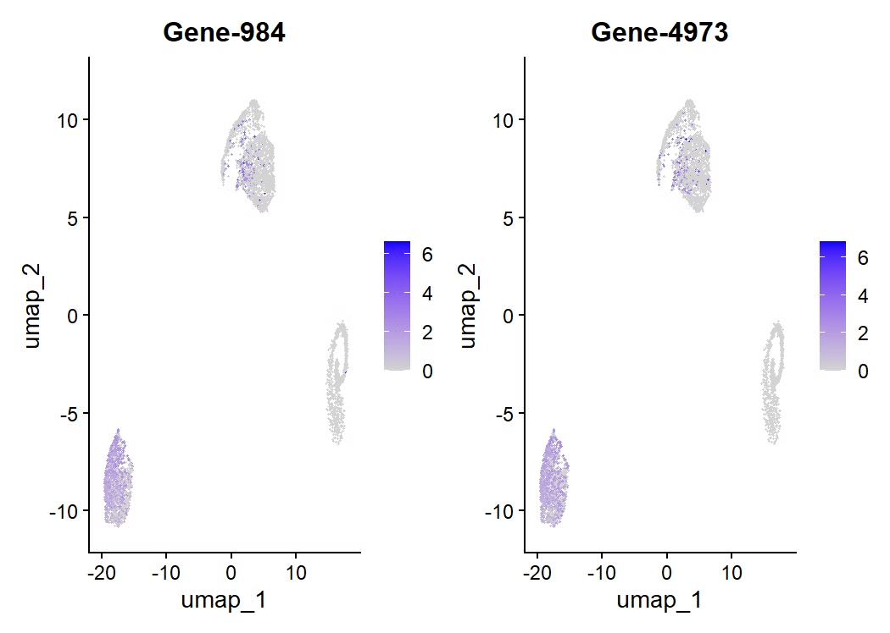



Objective and Dataset
Research Question
Characterize nasopharyngeal carcinoma tumor microenvironment at single-cell resolution.
Dataset
GSE150430 dataset containing processed count matrix from NPC tumor samples.
Analysis Approach
Apply dimensional reduction, clustering and marker identification techniques.
Expected Outcomes
Map immune cell infiltration and identify distinct tumor cell populations.

Slide 3
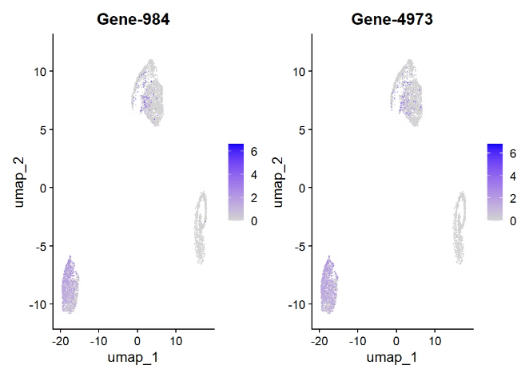
Clustering and UMAP Visualization
mmune Cell Assessment
Analyzed expression of canonical immune cell markers.
CD3D (T cells), CD14 (monocytes), and EPCAM (epithelial cells) showed minimal expression.
Results suggest sample contains predominantly tumor cells without significant immune infiltration.
Clustering Results
I
UMAP dimensionality reduction revealed two major cell clusters.
Type A (Cluster 0) and Type B (Cluster 1) demonstrate distinct transcriptional profiles.
Graph-based clustering algorithm identified clear separation between populations.

Slide 4



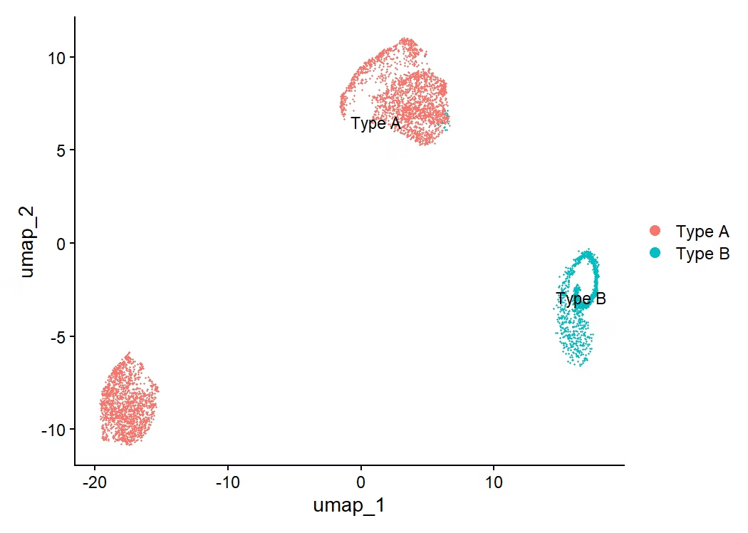

Marker Gene Discovery
Differential Expression Analysis
Cluster 0 Markers
Gene-984 and Gene-4973 show significant upregulation in Type A tumor cells.
Performed Wilcoxon rank-sum test to identify cluster-specific marker genes.
Selected markers with highest log fold-change and lowest p-values.
These genes are associated with proliferative cancer phenotypes.
Cluster 1 Markers
Gene-2042 and Gene-4423 are highly expressed in Type B tumor cells.
Expression patterns validated through feature plots and violin plots.

Slide 5
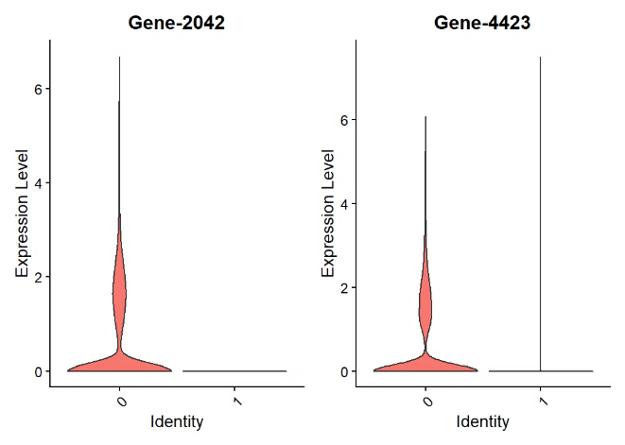
Conclusions
Tumor Microenvironment Composition
Analysis revealed predominantly tumor cells without significant immune infiltration. This contradicts our initial hypothesis about complex TME in this sample.
Tumor Heterogeneity
Identified two distinct tumor subtypes with unique transcriptional signatures. These molecular differences suggest potential functional variations between subtypes.
Future Directions
Validate marker genes through qPCR and immunohistochemistry. Apply automated annotation tools like SingleR to confirm cell type identities.

